Slide 1





FALL 2025
CROP PREDICTION USING CLIMATE FORECASTING
6 Crops
Analyzed
23 Districts
Covered
5 Years
Projections
A Data-Driven Approach to Agricultural Decision Support in Malawi
SARIMAX
Forecasting Model
Rading George Mitema
United States International University - Africa

Slide 2
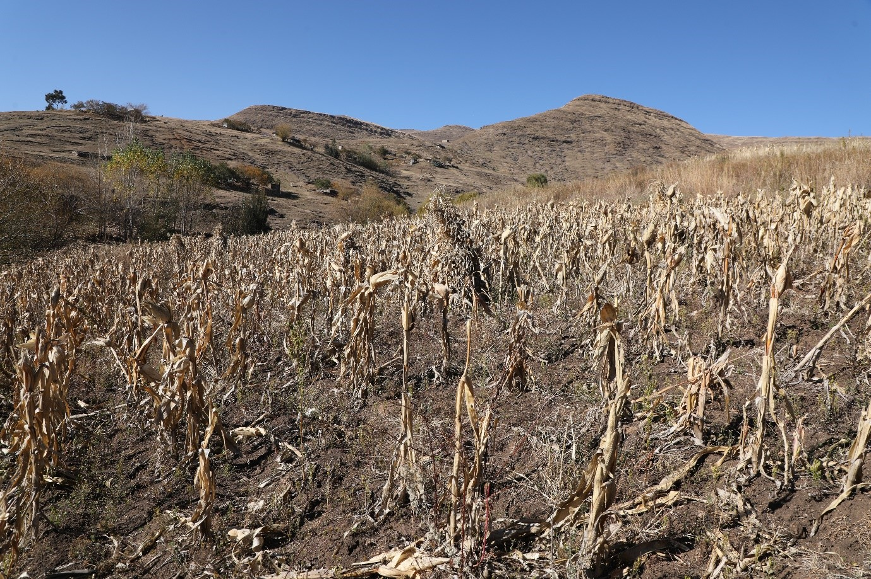






Why This Matters
80% Rural Households
Depend entirely on what they grow
Climate Crisis
Erratic rainfall, rising temperatures, unpredictable dry spells
Widespread Crop Failures
Across Malawi, causing food shortages
No Localized Guidance
National forecasts too general, no district-specific advice
Unreliable Decisions
Farmers rely on gut feeling and tradition — no longer works

Slide 3





Problem Statement
General Objective
Farming depends entirely on unreliable rainfall and climate change is making traditional approaches costly
Build data-driven crop prediction system merging climate forecasts with suitability scores
CHAPTER 01
Introduction
Specific Objectives
Research Questions
• Forecast climate variables (SARIMAX)
• Which crops suit different districts?
• Assess crop suitability (FAO thresholds)
• How accurate are SARIMAX models?
Exploring the intersection of climate forecasting and agricultural decision-making in Malawi
• Create web platform
• How to translate forecasts into clear advice?
• Test crop suitability
• What do regional differences reveal?
Study Scope
23 Districts across Malawi
6 Crops analyzed
2022-2025 data period

Slide 4




Theoretical Framework
• Design Science Research (DSR)
• Time-series forecasting theory
• Agroecological theory
• Decision Support System theory
CHAPTER 02
Literature
Review
Empirical Review
• NDVI and rainfall estimates have predictive signal for crop outcomes
• No forward-looking guidance systems exists, only monitoring and historical analysis
• Few systems use predictive modeling
Theoretical foundations and empirical gaps shaping the system design
• SARIMAX performs well in data-scarce African contexts
Conceptual Framework
Critical Gap
Satellite data → SARIMAX forecasting → FAO scoring → Web dashboard
No integrated tool combining satellite data, forecasting, and crop recommendations for Malawi

Slide 5
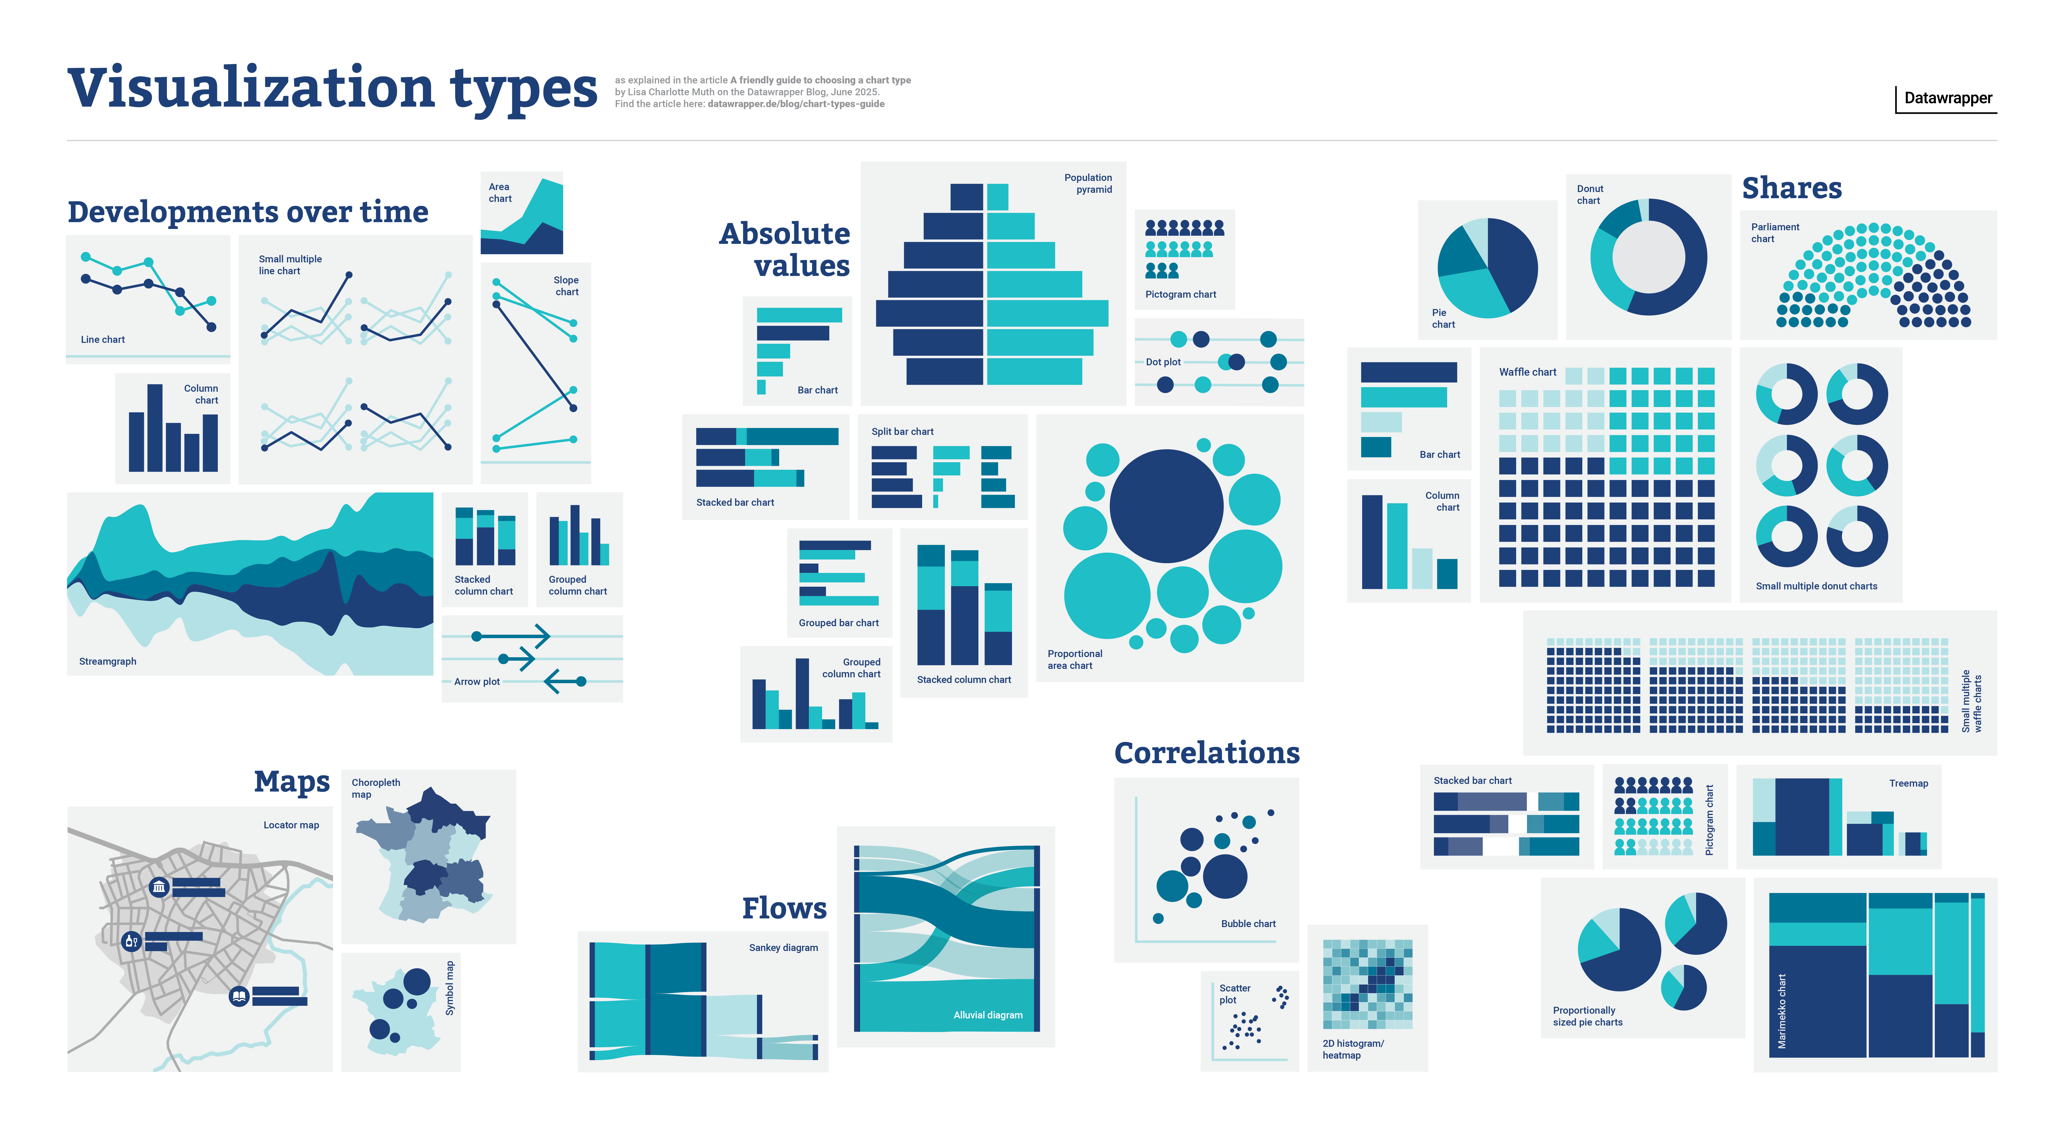




Methodology
CHAPTER 03
Research Design
Data Sources
Quantitative Design Science Research (DSR)
AAGWA Platform • Rainfall, LST, NDVI • Jan 2022-Feb 2025
Data Preprocessing
System Development
• Row-skipping & HTML removal
• Flask web framework
• Wide-to-long conversion
• models.py • services.py • app.py
• Missing value handling
• Dataset merging
Analysis Techniques
Order: 1,1,1,1,1,1,23
Suitability scoring
TimeSeriesSplit validation

Slide 6








Experiment Results
CHAPTER 04
Key Findings
Best Performing
Lowest Ranking
Regions Tested
Millet & Sorghum Most suitable across all districts
Rice High water requirements limit suitability
Chitipa
Lilongwe
Dowa
Northern
Central
Central
Forecast Accuracy (MAE)
Consistent Winner
Critical Finding
Cassava Ranked #1 in all three districts
Rice consistently shows MARGINAL
10.518
0.160
8.995
Rainfall (mm)
NDVI
LST (°C)
Suitability Patterns
Drought-resistant crops perform best. Vegetation health (NDVI) is a critical factor in crop suitability assessment.

Slide 7





Evaluation & Deployment
CHAPTER 05
Evaluation Criteria
Validation Process
• System Completeness
• TimeSeriesSplit cross-validation
• Suitability scoring validity
• FAO EcoCrop parameters
• Interpretability
• Cross-referenced outputs
Validation Results
Trend-based forecasts
FAO agronomic science
Non-specialist users
Deployment
Impact
• Flask web application
Provides localized five-year crop guidance where none existed before
• Downloadable PDF reports
• 30-second processing (cached)

Slide 8




Conclusions & Recommendations
CHAPTER 06
Research Summary
Key Findings
Limitations
Successfully built data-driven crop prediction system for Malawi
• Millet, Sorghum, Cassava favored
• No soil/irrigation/pest factors
• Rice most vulnerable
• Limited to climate variables
• Accuracy varies by region
Conclusions
Recommendations
• System provides interpretable, data-driven guidance
• Expand to more crops and incorporate soil data
• Fills critical gap between climate data and actionable advice
• Field testing with farmers for real-world validation
• Demonstrates value of transparent, rule-based AI in agriculture
• Regional deployment across Sub-Saharan Africa
This research demonstrates how climate-smart agriculture can provide practical, forward-looking guidance to farmers facing climate uncertainty

